Slide 1

Where’s my spaceship
TL 6
Qiwei liang
Weekly Status Report

Slide 2
GROUP MEMBERS
TL1: Adam Inventory, Menus, UI
TL2: Gabe Player Control / Character
TL3: Alex Level Design, Asset Connection
TL4: Urvashi Music
TL5: AJ Enemies
TL6: Qiwei Boss fight

Slide 3
Gantt Chart
https://vandalsuidaho-my.sharepoint.com/:x:/r/personal/gupt1374_vandals_uidaho_edu/Documents/Gantt%20Chart.xlsx?d=w97d8660fe21948aa96abc7ef1e9d3602&csf=1&web=1&e=S1Mra6

Slide 4
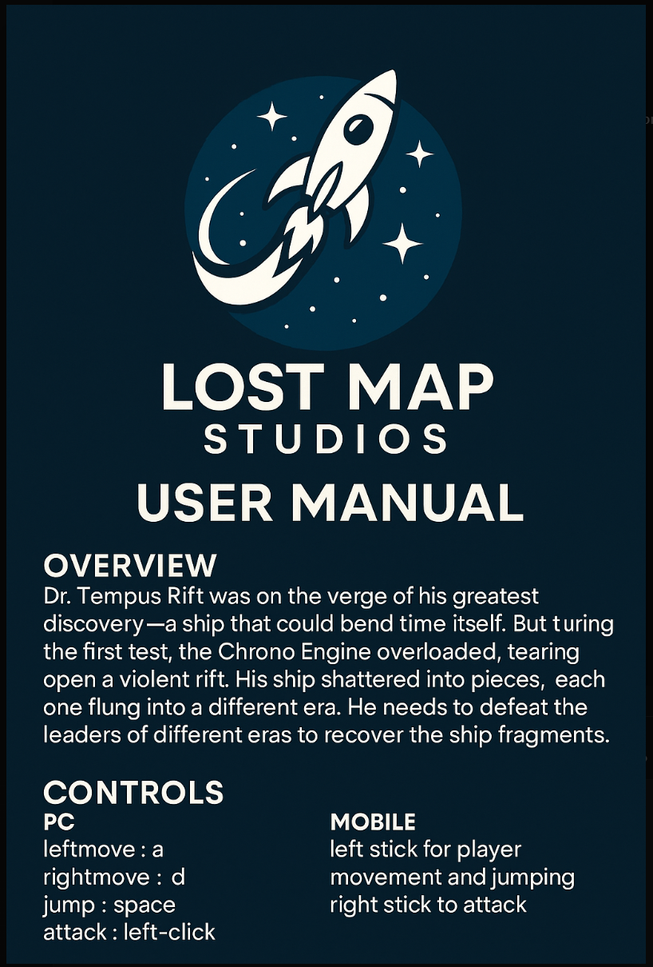
User manual

Slide 5
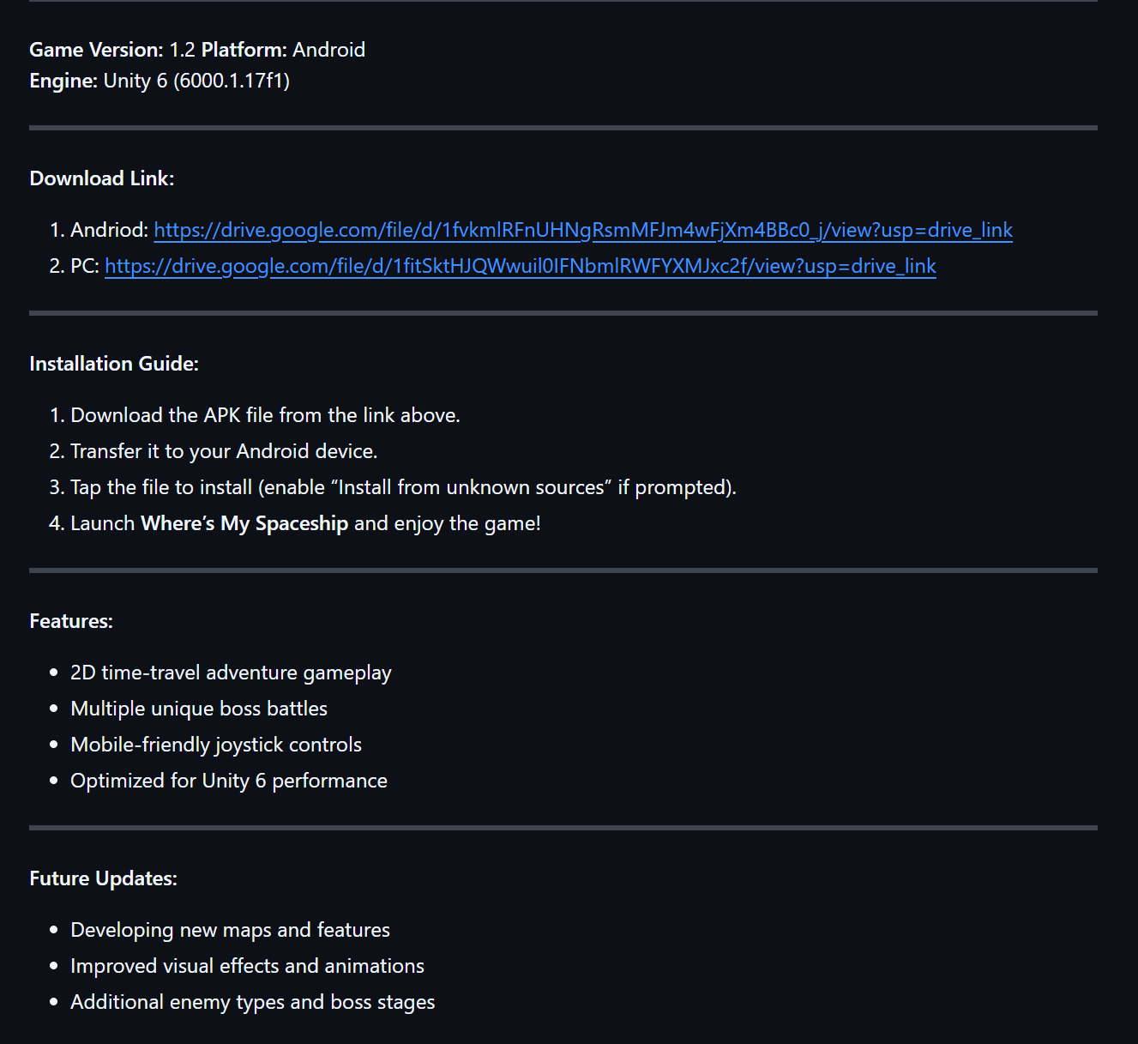
Readme

Slide 6
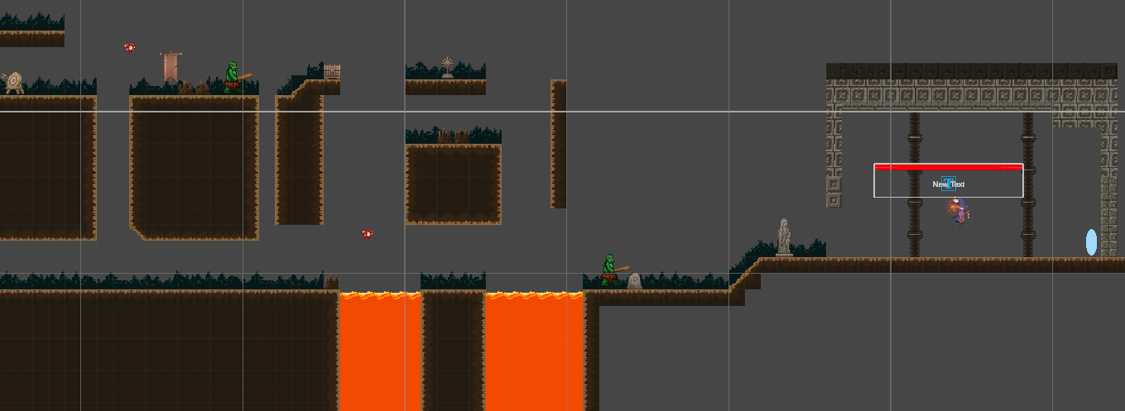
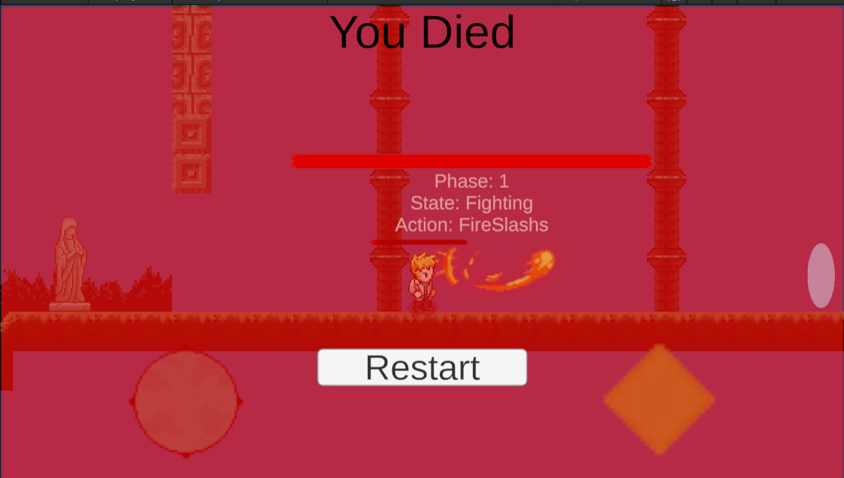
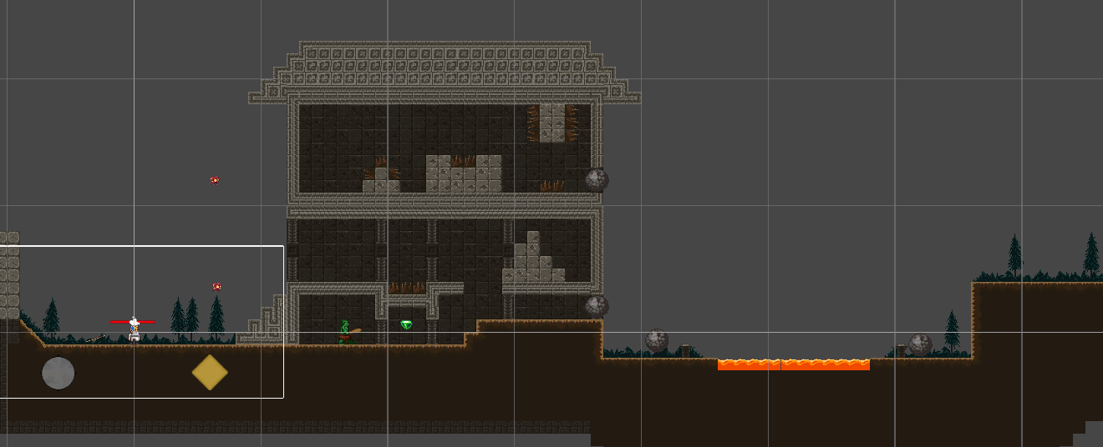
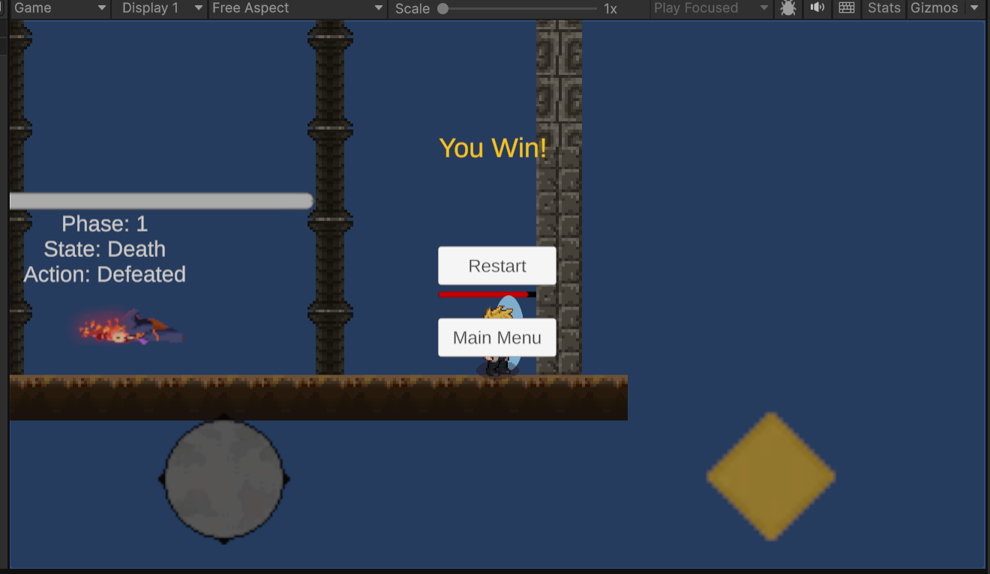

Slide 7
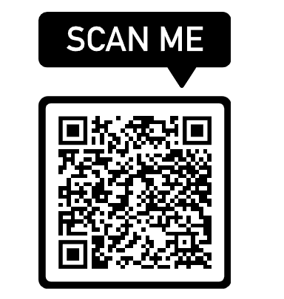
DEMO

Slide 8
For oral exam
Everyone knows the oral exam time
Weekly work:
TL1: Made new modifications to the in-game menu settings, such as a restart button and mute, play music in side the settings tab; made a death panel signaled when the player dies; made a Win panel signaled when the player defeats the boss/ enters through the portal.
TL2: Fixed issues with the spear, menues, and overall canvas issues, added a health bar, moved assets to the new scene, and made the volume slider work in the settings
TL3: Expanding levels, Adding functionality to hazards, Allowing switching between different levels, General polish and bugfixing
TL4: Added additional sounds and elements to the audio manager and audio mixer, implemented 33 new tests.
TL5: Fix the bug of enemies that was constantly flip and work on healtbar script for enemies.
TL6: Enhance the boss arena feature, improve the boss function, and connect the menu function to the boss arena.

Slide 9
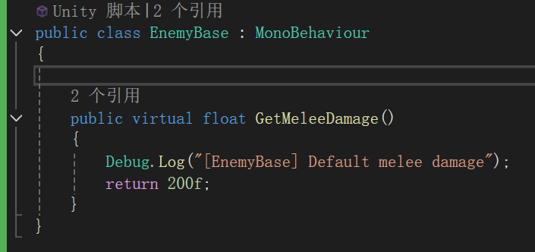
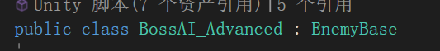
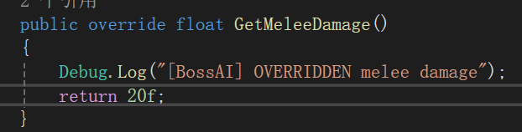
dynamic binding
When the keyword "virtual" is removed, the attack damage of Boss changes.

Slide 10
THANK YOU!

